Slide 1

G1- GAURAV PANDEY (2101220130032) RAJAT RAI (2101220130067) MOHD.WASEEM (2101220130047) KUSHAGRA GUPTA(2101220130043)
Title: “Weather Prediction Model: “A Data Science Project”

Slide 2
INTRODUCTION-
Weather prediction plays a crucial role in various sectors, including agriculture, transportation, disaster management, and daily life planning. Accurate forecasts help in preparing for and mitigating the effects of severe weather conditions.
In this project, we'll predict tomorrow's temperature using historical data. We'll start by downloading a dataset of local weather. You can customize this to your own location.
In this context, the presented code represents a practical application of machine learning for weather prediction.
In this do Clean and graph data, Create a testing framework , Improve model accuracy

Slide 3

STEP 1-This code imports necessary libraries for data processing and machine learning. Pandas- for data handling Numpy- for numerical operations Ridge-Adds a penalty to the linear regression model's loss function to reduce multicollinearity and prevent overfitting. mean_absolute_error - Measures the average absolute difference between predicted and actual values. mean_squared_error -Calculates the average of the squared differences between predicted and actual values,.
import matplotlib.pyplot as plt

Slide 4

STEP 2-In this we have loaded the dataset weather.csv to train the model, using pandas.
This data set is consist of 19287 rows × 44 columns.

Slide 5
Dataset
The dataset consists of 19,287 entries with 45 columns, each representing
various weather metrics. Here are the key aspects:
Key Columns:
STATION: weather station. NAME: Name of the location. DATE: recorded observation.
ACMH, ACSH: Accumulated metrics, likely related to precipitation.
AWND: Average wind speed (in mph). PRCP: Precipitation (in inches).
SNOW: Snowfall (in inches). SNWD: Snow depth (in inches).
TAVG, TMAX, TMIN: Average, maximum, and minimum temperatures (in Fahrenheit).
TSUN: Total sunshine (in minutes). WT01-WT22: Weather types like fog, rain, snow, etc.

Slide 6
Observations:
Missing Data: Some columns, like TSUN and WT01-WT22, have missing values.
Temperature Data: TMAX and TMIN are fully populated, making them reliable for analysis.
Possible Analysis:
Temperature Trends: Explore how temperatures vary over time.
Precipitation and Snow: Analyze the relationship between precipitation, snowfall, and snow depth.
Wind Speed: Investigate wind patterns using AWND.
Weather Conditions: Assess the frequency of different weather types using the WT columns.
This dataset provides a comprehensive overview of weather conditions, which can be used to predict future weather patterns using machine learning.
Dataset

Slide 7

STEP 3-Since for ML project we clean data like Remove Unknown data from data set calculate the percentage of missing values (nulls) for each column in the DataFrame

Slide 8
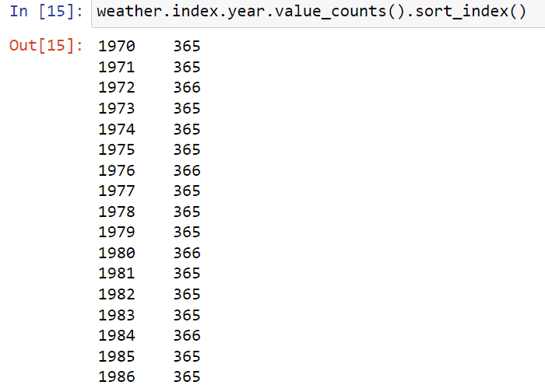


STEP4-Specify for each year how many records we have in total in sorted form.

Slide 9

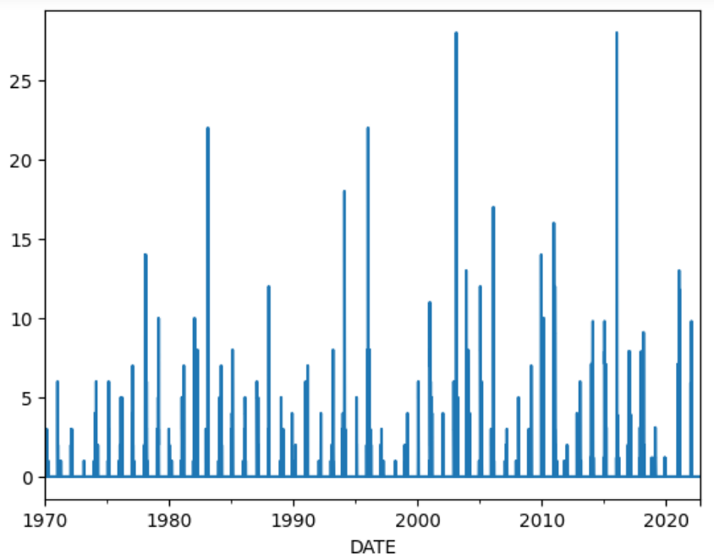
STEP5-We plot the snow that has accumulated on the ground day by day

Slide 10
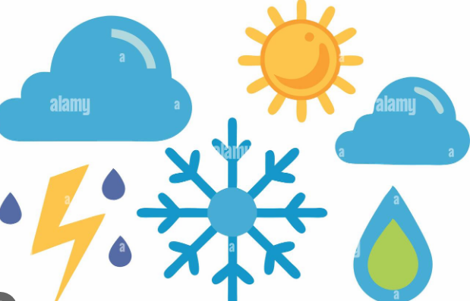
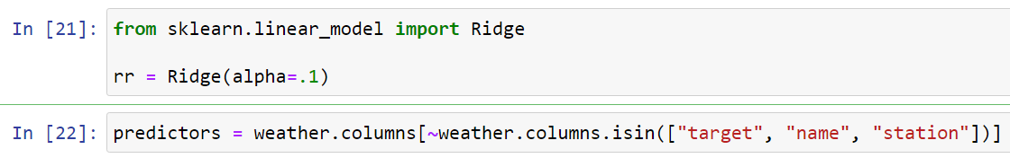
STEP6- To prepare and configure a Ridge Regression model, which will be used to predict weather variables. Ridge Regression is a type of linear regression that includes regularization to handle multicollinearity.

Slide 11
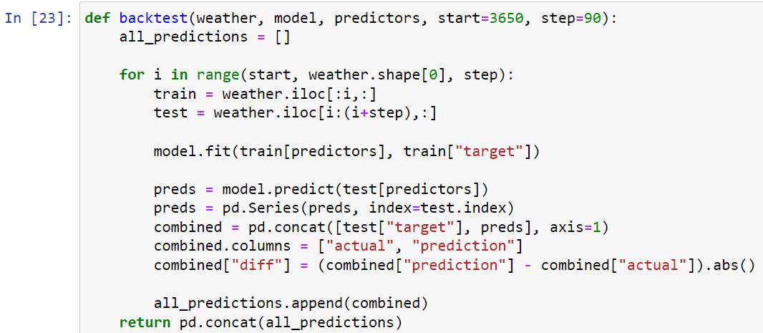
STEP 7-Since this is a time series data and In time series we can not use future data to predict past so we make backtest. *We prepare the model using training data set

Slide 12
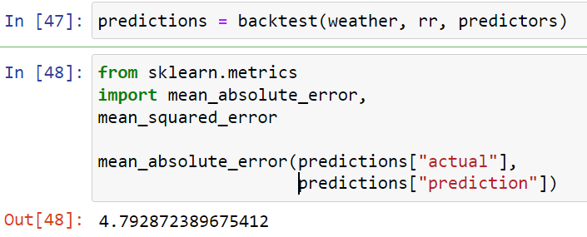
STEP 8-Now we call back test and do prediction. * find mean absolute error, mean squared error

Slide 13
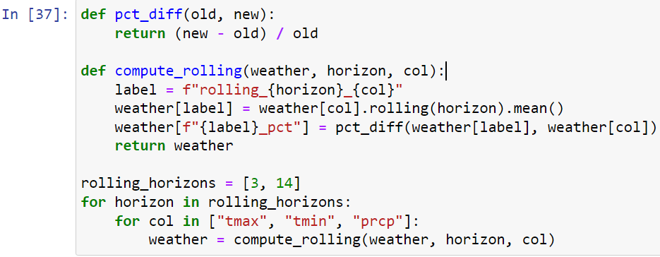
STEP 9-To increase accuracy we add more predictors do take mean of past few day like temperature,and precipitation.

Slide 14
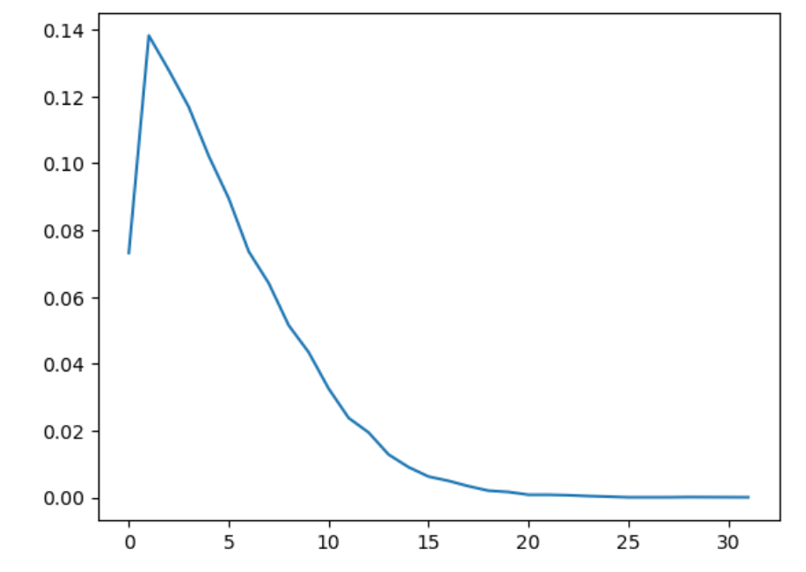
STEP 10- This code snippet calculates the frequency distribution of rounded prediction errors (diff) and normalizes it by the total number of predictions, then plots the resulting proportions. This helps visualize the distribution of prediction errors.

Slide 15
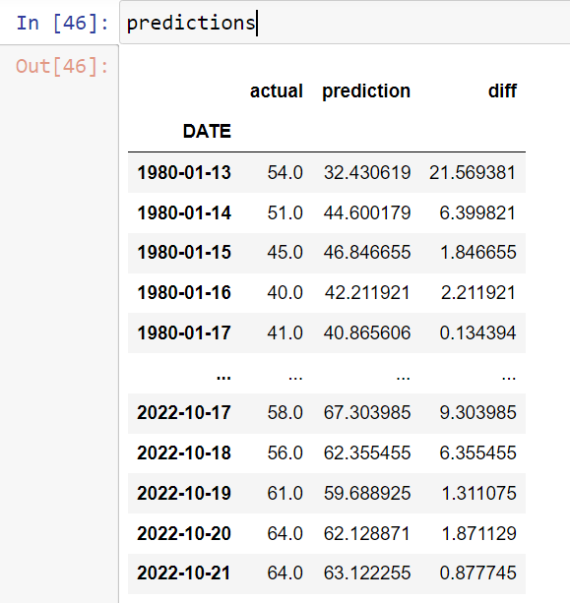
STEP11-Final Prediction with the most accuracy

Slide 16
THANK YOU

